Slide 1



Pandas vs Polars
The Ultimate Battle for High Performance in Python
Muhammad Adeel Sultan Khan
Data Scientist Agtech, Silicon Valley, California​
Notes:
Main Cover Slide Example. If a presentation will not be submitted for upload to the platform, providing a cover slide at a minimum is recommended for display throughout the Live Training.

Slide 2
Personal Background
Muhammad Adeel Sultan Khan
Ag tech Data Scientist Silicon Valley tech company over 5 years
Treasury Finance 8 years experience
MSIS Data Science Analytics, Santa Clara University
MBA San Jose State University
CFA Level 1 exam
BCS & MBA MIS, Institute of Business Administration

Slide 3

Agenda
Segment 1: Introduction Pandas vs. Polars
What is Pandas
What is the purpose and function of Polars
What makes Polars faster and more efficient than Pandas
Why Polars is more efficient for large datasets
How Polars handles larger than RAM data
What is Polars query optimization claim
Segment 2: Strengths & limitations of Polars & Pandas
Pandas vs Polars; syntax and speed comparison
How can we improve data mining performance
Segment 3: When to choose Polars
Examples of high-performance Pandas alternatives
Why choose Polars
Polars execution of code
Examples of multithreading and parallel computing
Installing Polars in Python
Demo of Polars vs Pandas data analysis

Slide 4
Poll Question
How familiar are you with using pandas for data science tasks like data mining? (one selection)
Beginner
Intermediate
Expert

Slide 5

What is Pandas
Pandas is python’s powerful & open source data manipulation & data analysis tool
Pandas key functions are data loading, aligning, manipulating & merging
Pandas has two data structures series(1-d) & dataframe(2-d)
Pandas has usecases in finance, statistics, healthcare, engineering, iot sensor data
Pandas help in the most complex data transformation tasks
Pandas helps in preparing data that is used for building ML & AI models

Slide 6
Pandas Data Types
Pandas is well suited for various types of data:
Tabular data with heterogeneously-typed columns, as in an SQL table or Excel spreadsheet
Ordered and unordered (not necessarily fixed-frequency) time series data.
Arbitrary matrix data (homogeneously typed or heterogeneous) with row and column labels
Any other form of observational / statistical data sets. The data need not be labeled at all to be placed into a pandas data structure

Slide 7
Pandas main tasks
Easy handling of missing data (represented as NaN) in floating point as well as non-floating point data
Size mutability: columns can be inserted and deleted from DataFrame and higher dimensional objects
Automatic and explicit data alignment: objects can be explicitly aligned to a set of labels, or the user can simply ignore the labels and let Series, DataFrame, etc. automatically align the data for you in computations
Powerful, flexible group by functionality to perform split-apply-combine operations on data sets, for both aggregating and transforming data
Make it easy to convert ragged, differently-indexed data in other Python and NumPy data structures into DataFrame objects

Slide 8
Pandas main tasks
Intuitive merging and joining data sets
Flexible reshaping and pivoting of data sets
Hierarchical labeling of axes (possible to have multiple labels per tick)
Robust IO tools for loading data from flat files (CSV and delimited), Excel files, databases, and saving / loading data from the ultrafast HDF5 format
Time series-specific functionality: date range generation and frequency conversion, moving window statistics, date shifting, and lagging.
Intelligent label-based slicing, fancy indexing, and subsetting of large data sets

Slide 9
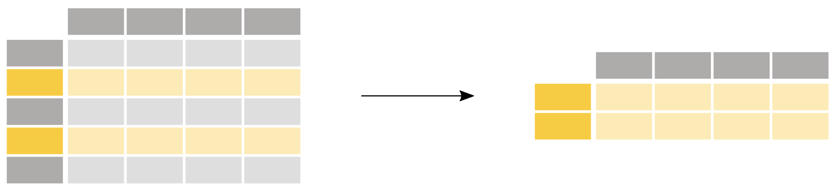
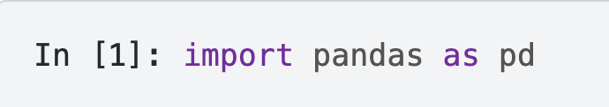
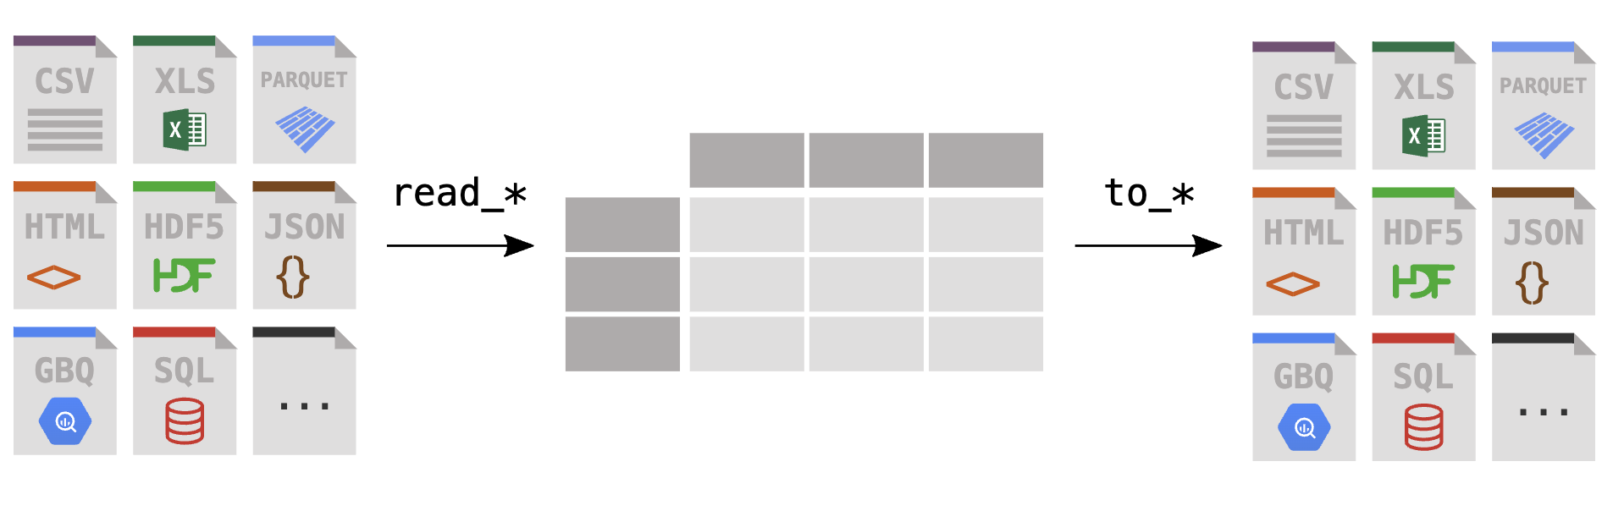
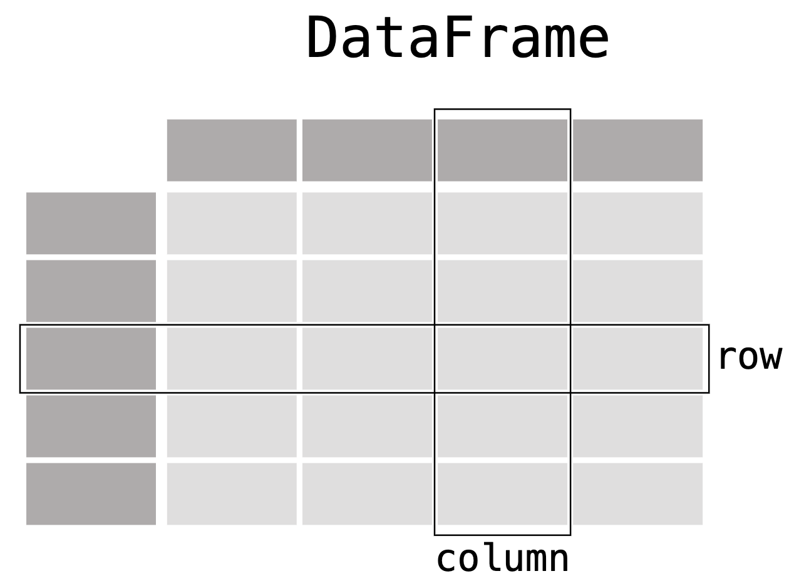
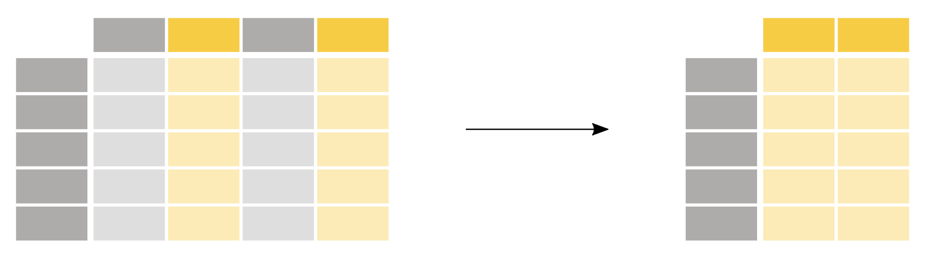
Pandas data handling
Selecting rows
Reading & writing data
Selecting columns

Slide 10
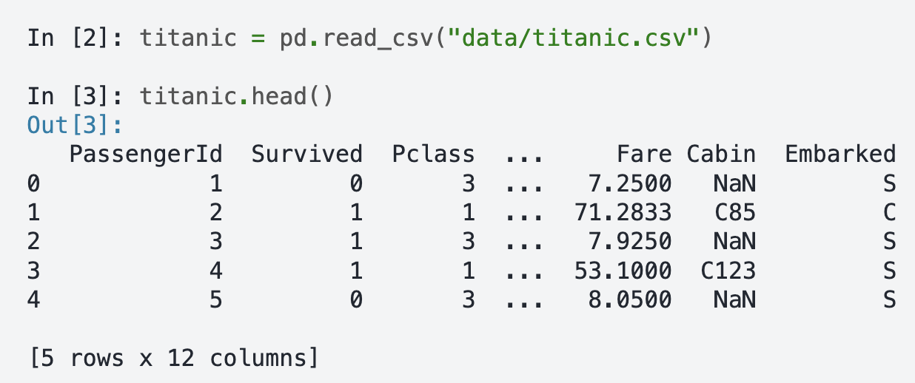
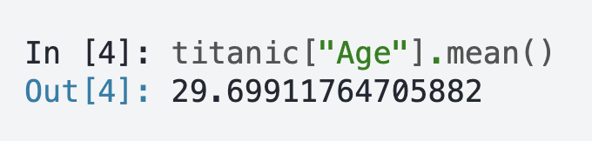
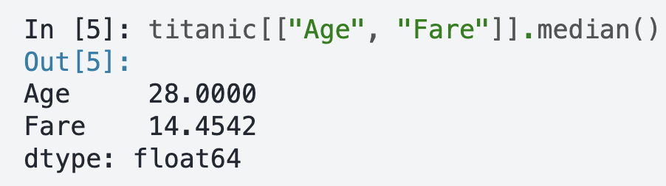
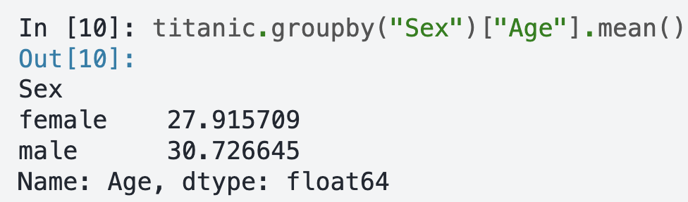
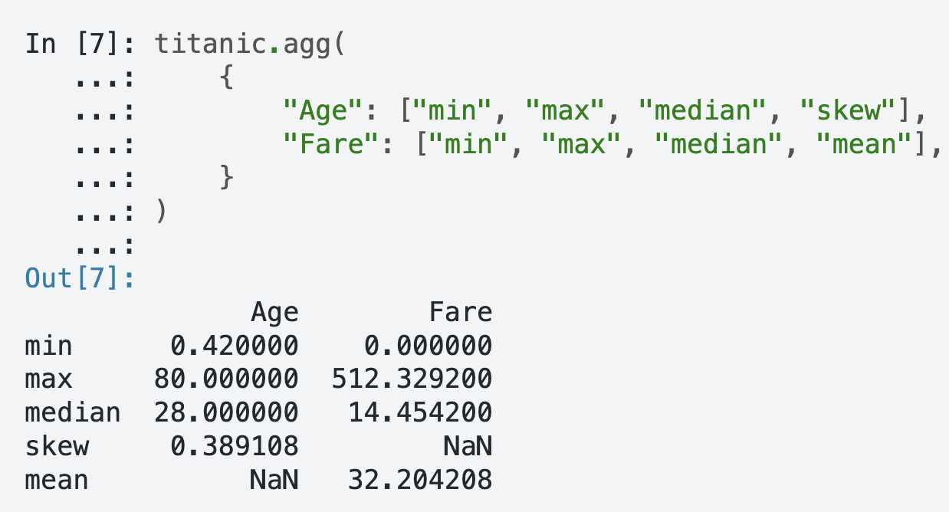
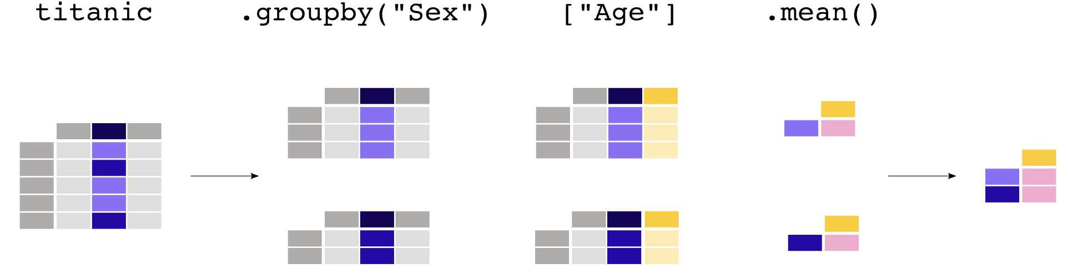
Data Mining with Pandas
Pandas help calculate summary statistics

Slide 11
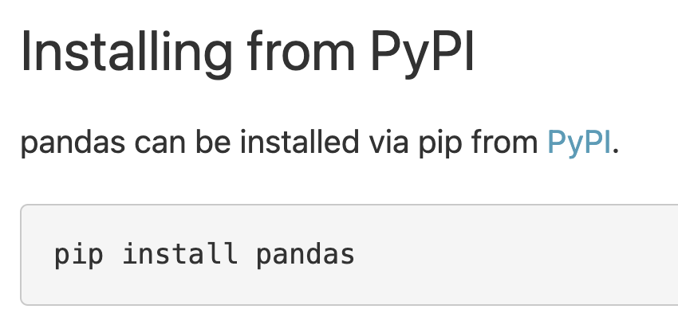
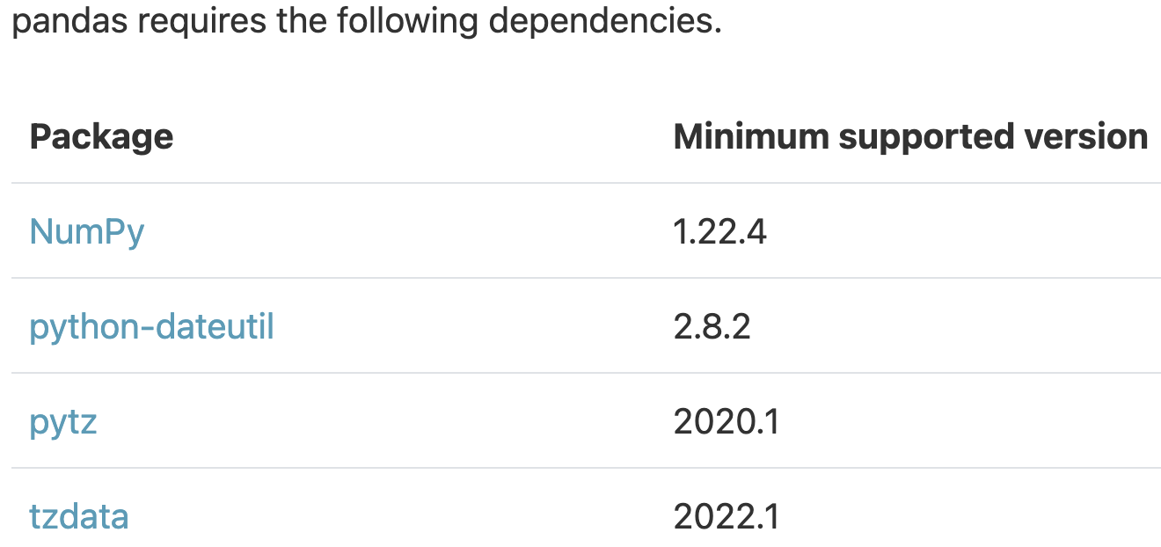
Pandas package version
2.2.0 (Jan 19 2024)
2.1.4 (Dec 8 2023)
2.0.3 (Jun 28 2023)
1.5.3 (Jan 18 2023)
1.4.4 (Aug 31 2022)
1.3.5 (Dec 12 2021)
1.2.5 (Jun 22 2021)
1.1.5 (Dec 7 2020)
0.4 (Oct 9 2011)

Slide 12
Poll Question
What are the two most popular pandas data structures?
Series: 1d labelled array
DataFrame: 2d labelled tabular structure
Lists
Tree

Slide 13
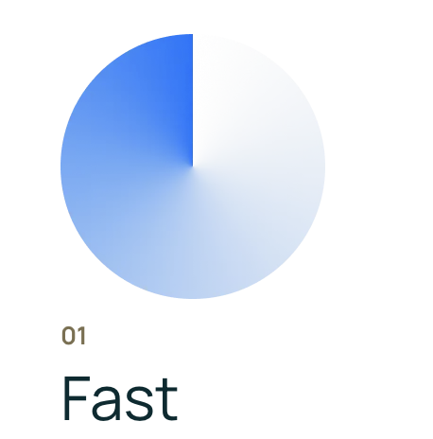
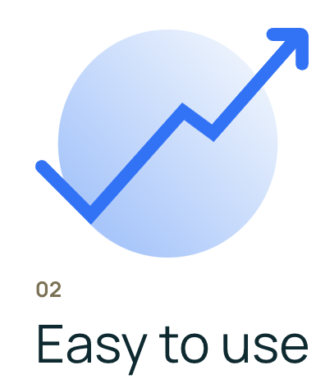

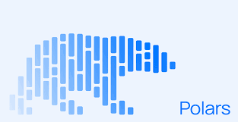
What is Polars
Polars is a high performance dataframe package for data analysis
It is designed to be faster, efficient & provide parallel processing
Polars is especially suited for larger than memory datasets (>GB)
Polars is A Python & Rust library; blazingly fast & memory efficient
Polars utilizes multiple CPU cores at once
Polars provides smooth transition from pandas with minimum hastle
Polars enhances performance & utilizes machine resources efficiently
Polars supports lazy evaluation: delaying query/operation execution until needed

Slide 14
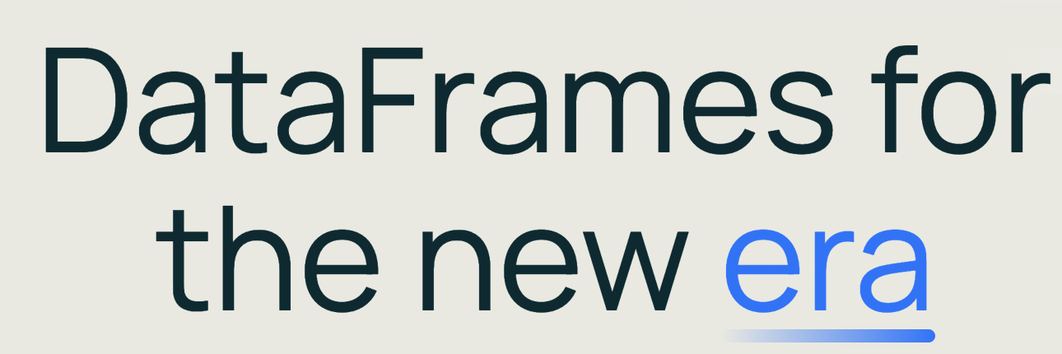

What is the purpose/function of Polars
The goal of Polars is to provide lightning fast DataFrame library that:
Utilizes all available cores on your machine.
Optimizes queries to reduce unneeded work/memory allocations.
Handles datasets much larger than your available RAM.
Has an API that is consistent and predictable.
Has a strict schema (data-types should be known before running the query).
Polars combines the flexibility and user-friendliness of Python with the speed and scalability of Rust

Slide 15

What is the purpose/function of Polars
Polars is written in Rust which gives it C/C++ performance and allows it to fully control performance critical parts in a query engine. Rust’s ability to be immediately compiled into machine code without the use of an interpreter can make it faster than Python.
Polars enables to:
Reduce redundant copies.
Traverse memory cache efficiently.
Minimize contention in parallelism.
Process data in chunks.
Reuse memory allocations.

Slide 16
Polars Key Features
Powerful API: Polars offers easy to use API for data manipulation & analysis tasks. It includes wide range of data aggregation & transformation operations including filtering, sorting & joining
High Performance: Polars leverages multithreading by using parallelized data processing executed on multiple threads of multi-core processors
Optimized Queries: Polars offers query optimization techniques using optimized data access patterns & minimized data movement
Hybrid Streaming( larger than RAM datasets): Polars uses streaming method to work on larger-than-memory datasets by using small batches of data

Slide 17
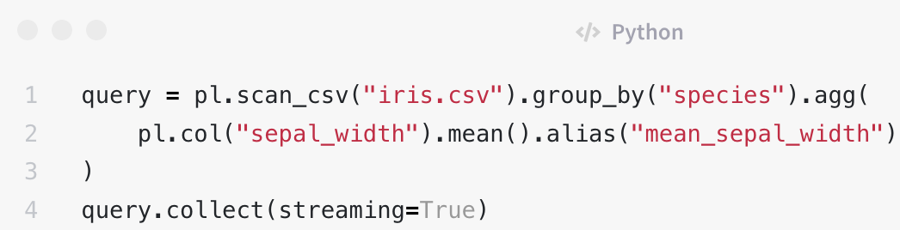
Polars Key Features
Streaming implies working on data in batches rather than at once
Streaming is only used in lazy mode in polars
Lazy & Eager execution: Polars support both lazy and eager execution(used by pandas) of data. Lazy execution defers operations until results are needed, while eager execution executes operations immediately when called.

Slide 18

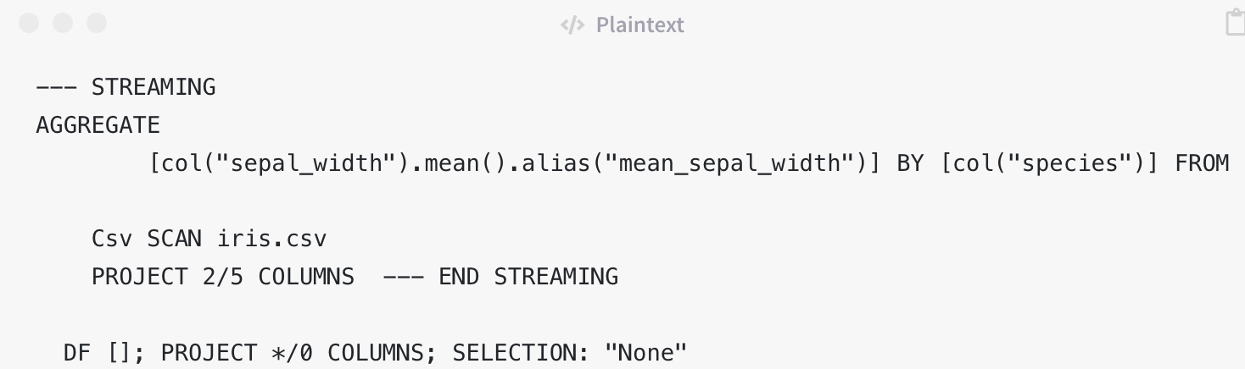
Polars Key Features
To determine which parts of your query are streaming, use the explain method

Slide 19
What makes Polars faster & more efficient than Pandas
Performance: Polars is designed for high performance, leveraging Rust's multi-threading, SIMD instructions, and query optimizations. In contrast, Pandas is primarily single-threaded, which may not be as efficient for large datasets or complex operations compared to Polars. Combining the ability to do streaming, as well as lazy execution, and Polars has a strong claim to being the better package for datasets above GB size.
Memory Model: Polars uses Apache Arrow Columnar Format as its memory model, optimized for data processing while Pandas, on the other hand, uses a row-based memory format. This makes Pandas less efficient for certain operations (which are quite common) like column-wise computations and aggregations.
Notes:
SIMD stands for Single Instruction, Multiple Data. This powerful approach allows a single CPU instruction to process multiple data points simultaneously. Imagine you're working with an image or two vectors. Normally, operations on these data points would be performed one at a time - a method known as scalar operation

Slide 20
What makes Polars faster & more efficient than Pandas
Syntax and API: Polars has a syntax and API that is similar to Pandas, making it easy for users familiar with Pandas to transition to Polars
Data Types: Polars provides a more extensive set of data types compared to Pandas, including advanced data types like Date64, datetime, and Interval, as well as support for custom data types, providing greater flexibility for handling diverse data types.
Rust advantage: Since polars is written in Rust, it utilizes the benefits of concurrency which allows parallelism. This enables Polars to use all machine cores while Pandas uses only single core to carry out data processing operations.

Slide 21
What makes Polars faster & more efficient than Pandas
Pandas 2.0 is designed to support Apache Arrow for data memory thus leading to performance improvements
However, Polars continues to be faster than Pandas 2.0 based on:
Rust advantage; Rust’s ability to be compiled into machine code without use of interpreter makes it faster than Python.
Parallelism
Interoperability (no need to convert data into other types in memory)
Query Optimization (lazy & eager)
Expressive API ( avoids Pandas apply method which loops over all rows of dataframe)

Slide 22
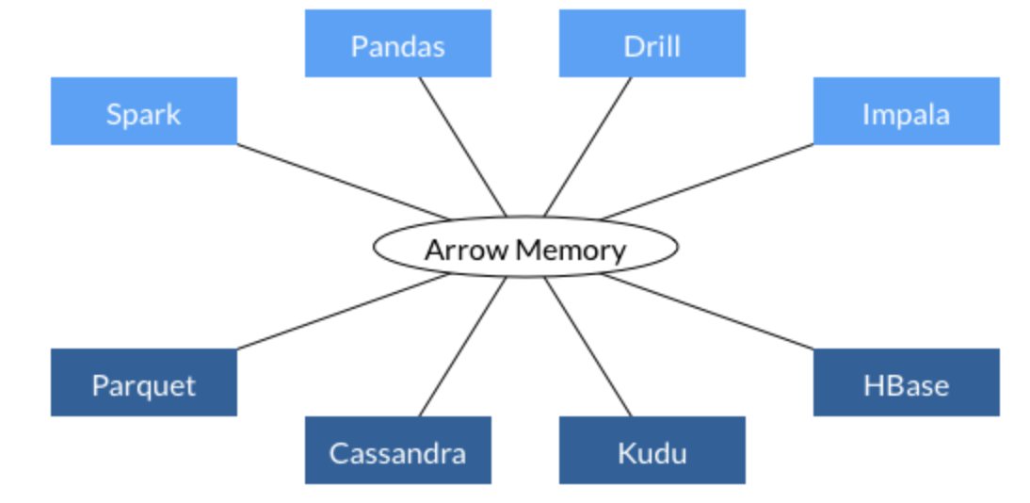
Why is Polars so fast
Written in Rust: low level language with minimal runtime & memory related bugs, provides concurrency & parallelism. Pandas is built on python and numpy which makes it slow
Based on Arrow: Apache Arrow is language independent memory format that provides interoperability which:
Speeds up performance as it avoids converting data to other formats in data pipeline
Arrow standardizes the in-memory data format
Arrow is memory efficient - two processes can share the
same data without needing to make a copy.
Notes:
This interoperability speeds up performance as it bypasses the need to convert data into a different format to pass it between different steps of the data pipeline (in other words, it avoids the need to serialize and deserialize the data). It is also more memory-efficient, as two processes can share the same data without needing to make a copy. As serialization/deserialization is estimated to represent 80–90% of the computing costs in data workflows, Arrow’s common data format lends Polars significant performance gains.

Slide 23
Apache Arrow Advantage
Apache arrow contributes to polar’s fast performance
Arrow was created by Wes McKinney to address big datasets issues with pandas
It is also the backend for pandas 2.0, a more performant version of pandas released in March of this year.
Pandas 2.0 is built on PyArrow, the Polars team built their own Arrow implementation
Arrow has built-in support for a wider range of data types than pandas. As pandas is based on NumPy, it is excellent at handling integer and float columns, but struggles with other data types.
In contrast, Arrow has support for datetime, boolean, binary, and even complex column types, such as those containing lists. In addition, Arrow is able to natively handle missing data, which requires a workaround in NumPy.
Finally, Arrow uses columnar data storage, which means that, regardless of the data type, all columns are stored in a continuous block of memory. This not only makes parallelism easier, but also makes data retrieval faster.

Slide 24
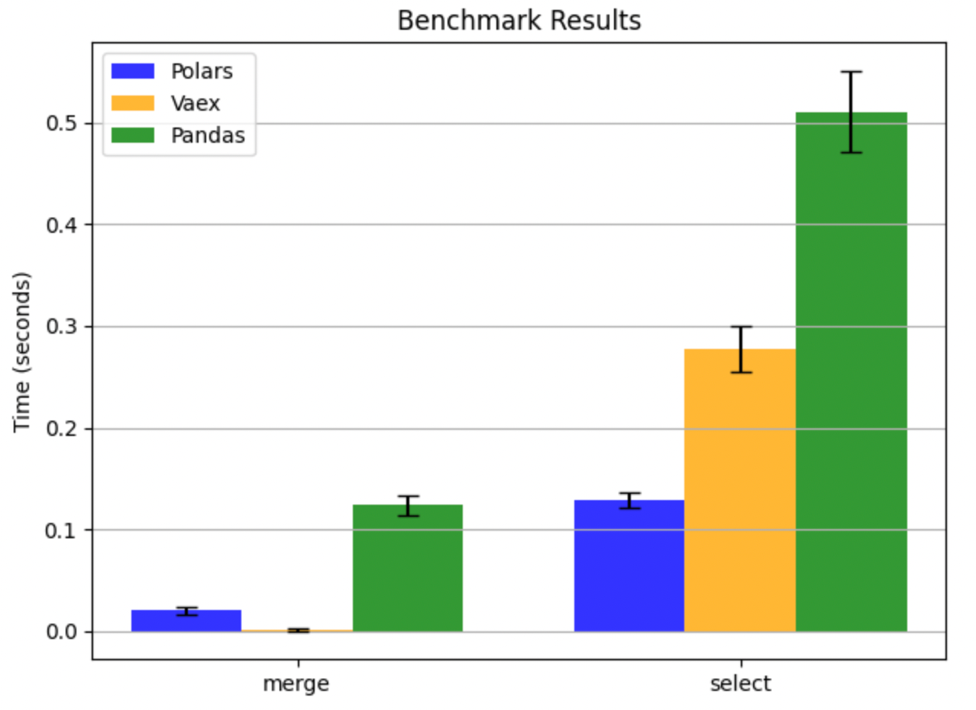
Why is Polars so fast
Pandas 2.0 is built on PyArrow but Polars has its own implementation of Arrow
Arrow has built-in support for wide range of data types than pandas
Pandas is built on NumPy, it supports integer & float only with ease
Polars’ Arrow supports datetime, boolean, binary and lists datatypes
Arrow can handle missing data which requires imputation in
pandas numpy
Polars Arrow memory uses columnar data storage which stores
all columns in a continuous block of memory regardless of data type
This supports both parallelism and faster data retrieval

Slide 25


Rust Advantage
Performance: Rust is blazingly fast and memory-efficient: with no runtime or garbage collector, it can power performance-critical services, run on embedded devices, and easily integrate with other languages.
Reliability: Rust’s rich type system and ownership model guarantee memory-safety and thread-safety — enabling you to eliminate many classes of bugs at compile-time
Productivity: Rust has great documentation, a friendly compiler with useful error messages, and top-notch tooling — an integrated package manager and build tool, smart multi-editor support with auto-completion and type inspections, an auto-formatter, and more

Slide 26
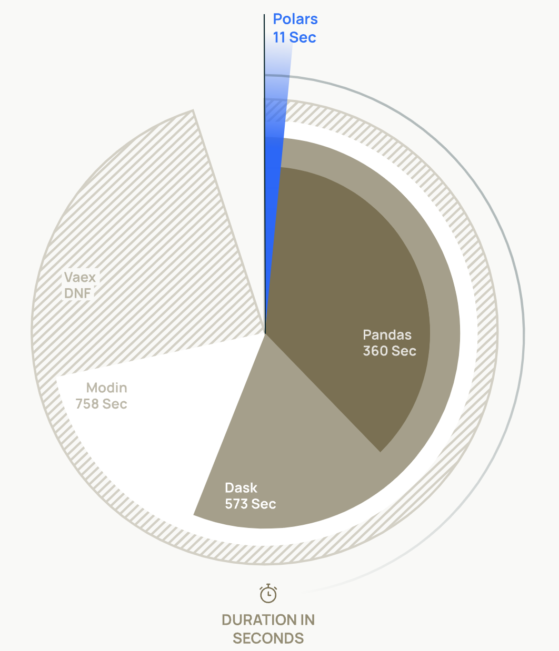
Why use Polars over Pandas
Polars memory requirement for data operations is much smaller than Pandas
Pandas require 5 to 10 times as much RAM as the size of a dataset
Polars require 2 to 4 times as much RAM as the size of the dataset
Polars is 10 and 100 times faster than Pandas for operations
Polars was benchmarked against other solutions using TPCH benchmark
The benchmark results showed Polars had performance gains over others due to its
parallel execution engine, vectorization with SIMD(single instruction multiple data) protocol
The results of the benchmark showed Polars can achieve 30x performance gains over pandas
Notes:
The TPC-H is a decision support benchmark. It consists of a suite of business oriented ad-hoc queries and concurrent data modifications. The queries and the data populating the database have been chosen to have broad industry-wide relevance. This benchmark illustrates decision support systems that examine large volumes of data, execute queries with a high degree of complexity, and give answers to critical business questions.

Slide 27
Poll Question
Which programming language polars is built on? (single selection)
R
Java
Rust
Javascript

Slide 28
Why Polars is efficient for large datasets
Polars is fast and efficient for large datasets mainly due to:
Rust advantage: compiles code without an interpreter, low resource usage
Memory usage: efficient memory allocation less copying of dataframes
Parallel execution: utilizes all CPU cores to process multiple instruction simultaneously
Lazy evaluation: operations are computed only when necessary
Polars has been specifically designed to handle large datasets efficiently. With its lazy evaluation strategy and parallel execution capabilities, Polars excels at processing substantial amounts of data swiftly

Slide 29

Why Polars is efficient for large datasets
Polars is a Python library for data manipulation that utilizes Apache Arrow as its underlying data structure.
With Polars, users can efficiently work with large datasets in memory using tools like filtering, aggregation, grouping, and manipulation.
Apache Arrow is designed for efficient in-memory processing and transferring data between different systems and languages. Its columnar data format enables efficient data processing than rows, while support for zero-copy memory allocation ensures that Polars can handle very large datasets with minimal memory usage. It saves the CPU from copying data from one memory to another.
Notes:
Zero copy data access (ZCDA) is a technique that allows data to be transferred between applications without being copied from one memory location to another. It can improve the performance of data-intensive applications by reducing the amount of time it takes to move data between different parts of the system

Slide 30
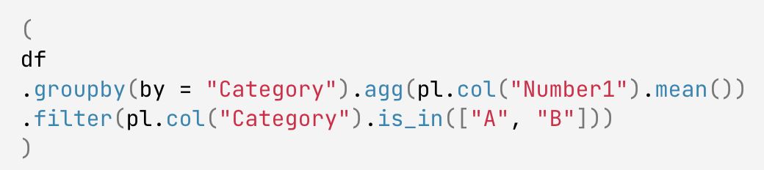
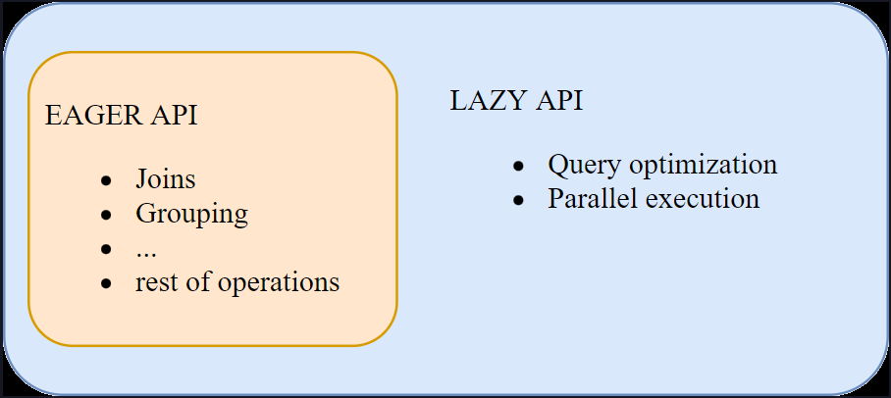
What is Polars Query Optimization claim
Query Optimization: Polars processes code in either lazy or eager execution. Pandas uses eager execution carrying out operations in the order of the written code. Lazy strategy evaluates all the operations and maps out the most efficient way to process:
The following code finds the mean of column Number1 for each of the categories “A” and “B” in Category:
If this is eagerly executed, the groupby operation will be unnecessarily performed for the whole dataframe, and then filtered by Category. With lazy execution, the dataframe can be filtered and groupby performed on only the required data.

Slide 31

How Polars handles larger than RAM data
Polars uses streaming mode for larger than memory datasets on a single machine
Streaming mode uses batches of data rather than all at once like a for loop processing each batch in turn. Streaming occurs in lazy mode by using streaming=True
Polars can handle some larger-than-memory data even without streaming
Polars also uses predicate pushdown to filter dataframes without reading all data into memory
Predicate pushdown applies filter as early as possible at scan level to filter data at the source, reducing the amount of data transmitted and processed

Slide 32
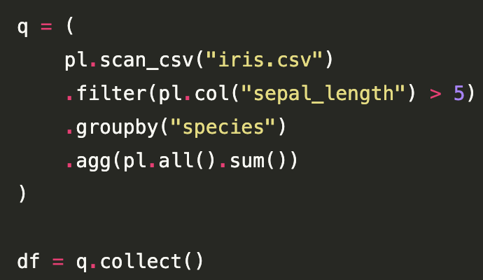
How Polars handles larger than RAM data
Polars also offers a Spark-like Lazy API for even better performance. The scan_csv command unlike the read_csv command lazily loads the file instead of reading the entire file into memory at once:
In the above example, Polars applies predicate pushdown by filtering down to only the records where the sepal_length is greater than 5. It applies projection pushdown by only selecting the columns that are needed. As a result, only a subset of the data is loaded into memory.

Slide 33
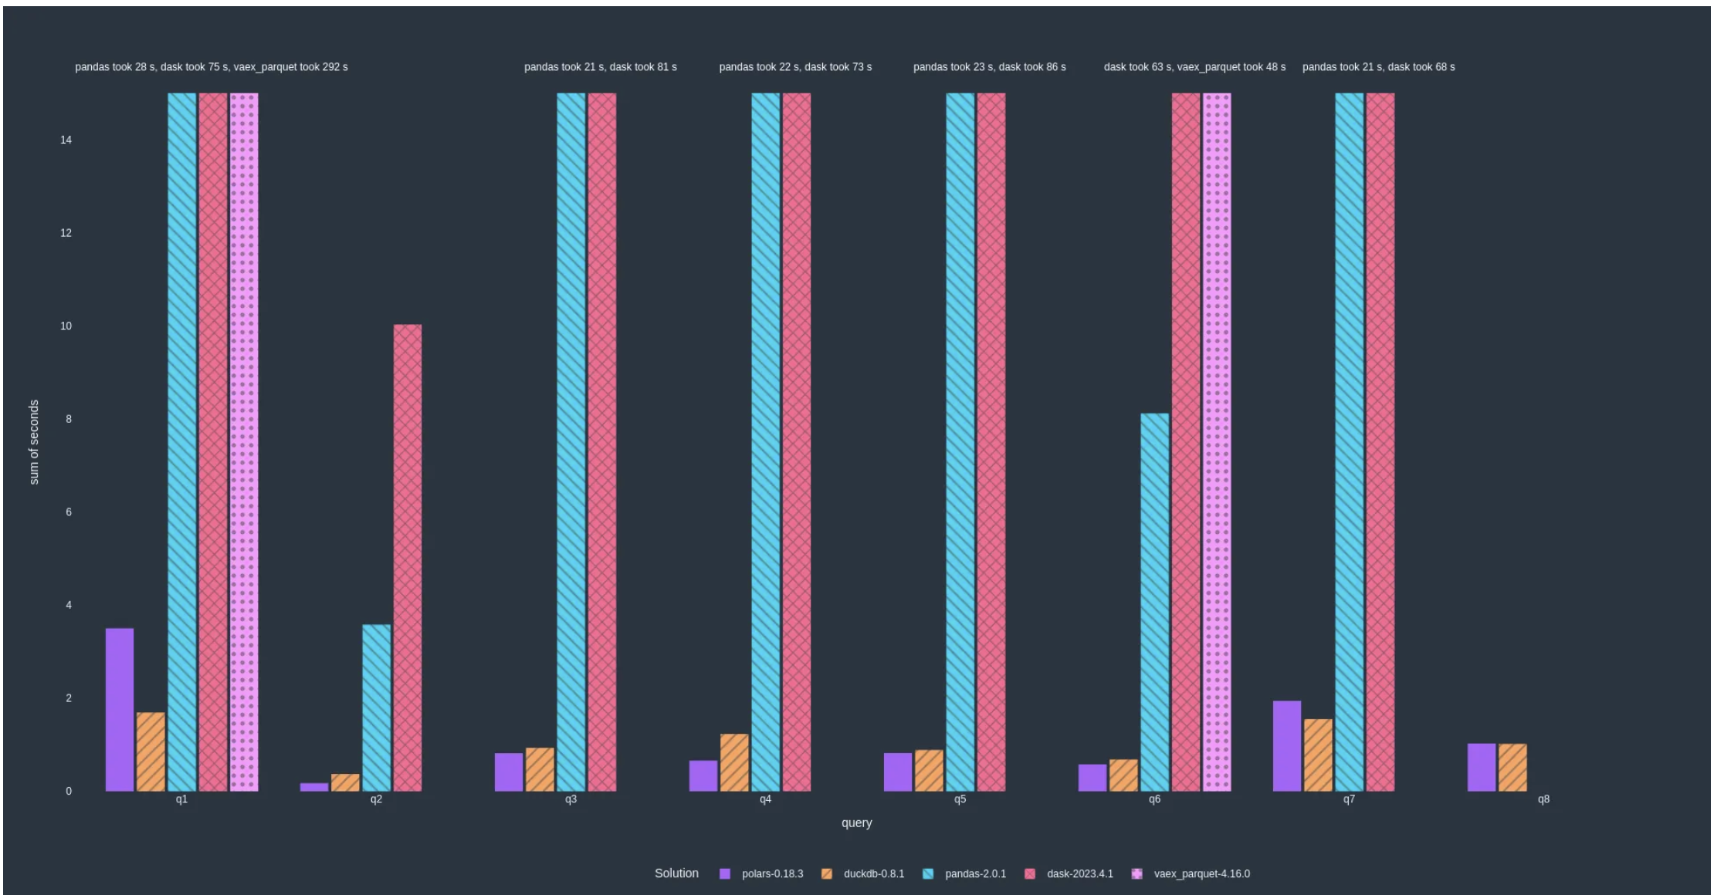
Results of reading parquet (lower is better)
Notes:
Apache Parquet is a column-oriented, open-source data file format for data storage and retrieval. It offers high-performance data compression and encoding schemes to handle large amounts of complex data. We use the to_parquet() method in Python to write a DataFrame to a Parquet file

Slide 34
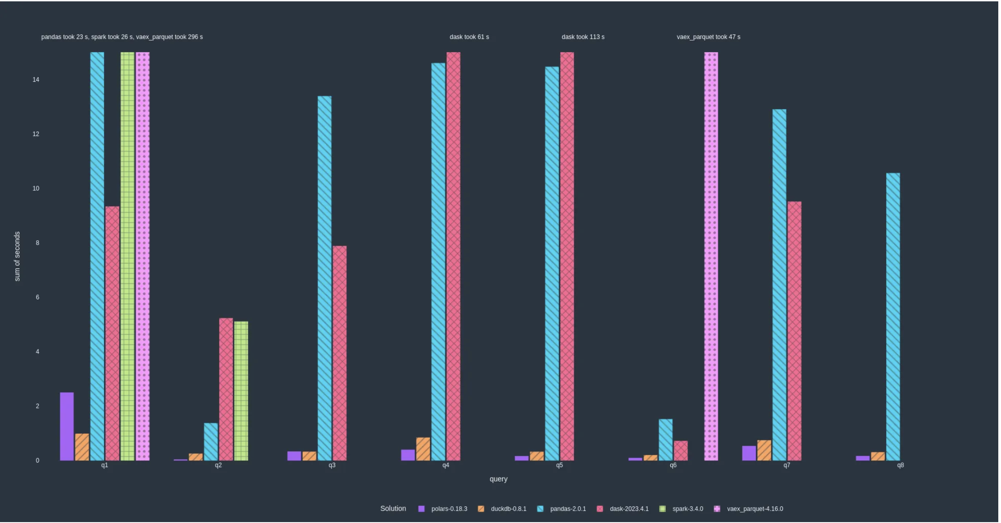
Results of in-memory data (lower is better)

Slide 35
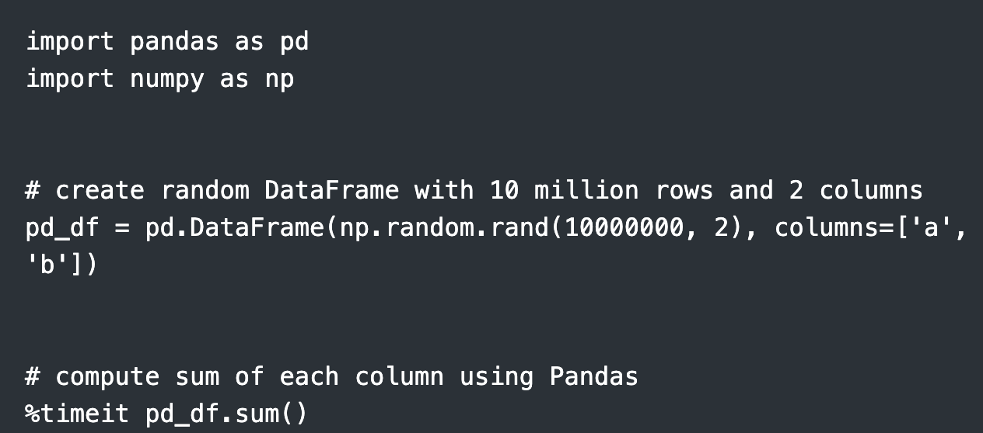
Polars vs Pandas speed comparison
Polars is fast for big data based on Rust advantage
Finding sum of 10 million records:

Slide 36
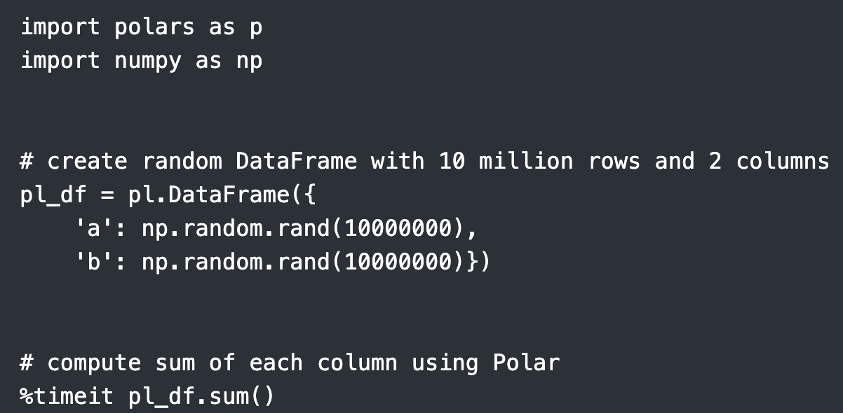
Polars vs Pandas speed comparison

Slide 37

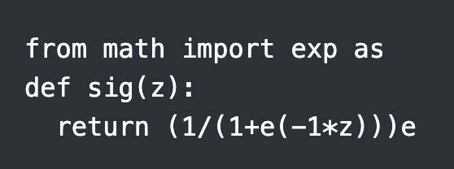
Polars vs Pandas speed comparison
It takes pandas 472 ms to sum 10mil observations; that's ± 6.5 ms per loop that is only two features. The real data often contain hundreds of features called Big Data. The time will increase exponentially once the sum function is replaced with a complex function or the datatype to string/object type
It takes polars 14.3 ms to sum 10mil observations; that's ± 2.27 ms per loop!
Polars is 34 times faster than pandas for the sum function
Sigmoid function applied to the observations:

Slide 38
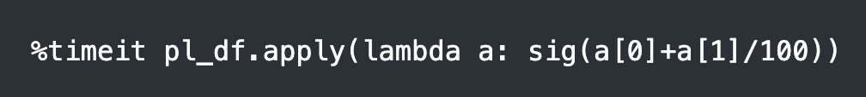
Polars vs Pandas speed comparison
Pandas
Polars
Polars is 10 times faster than Pandas for apply function
Where it takes Polars 0.13min to run the sigma function on 10 million observations Pandas take 1.5min to do that same. Polars ran the ‘apply()’ function 10 times faster Pandas.

Slide 39
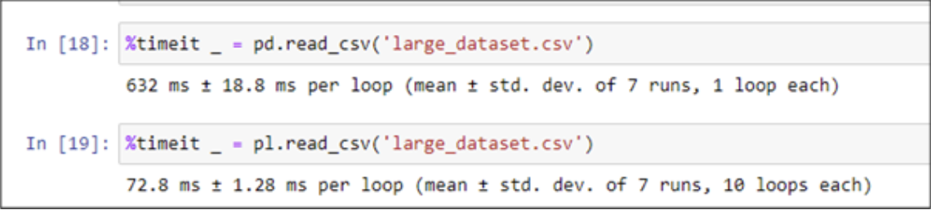
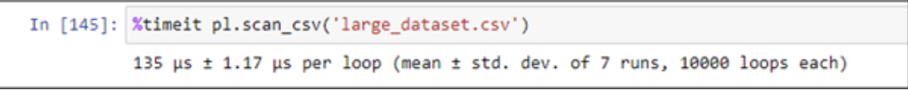
Performance comparison of Polars with Pandas
Following operations performed on a large dataset with 1 million rows:
Import speed
Polars import is 90 times faster than pandas import which is useful when handling large datasets. We can also use lazy load for even faster load and lazy evaluations:

Slide 40
Poll Question
In which scenario polars is faster than pandas? (single selection)
Data visualization
Machine Learning
Handling large datasets
Cloud computing

Slide 41
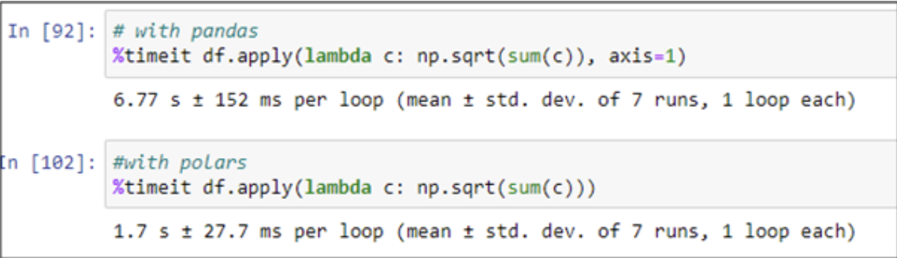
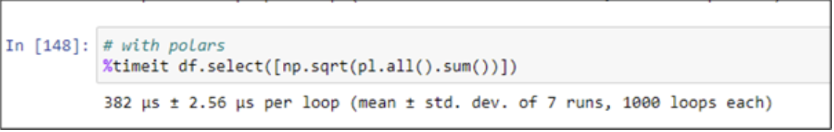
Performance comparison of Polars with Pandas
Apply Function:
A similar query can be further made faster by using the expression system provided by Polars

Slide 42
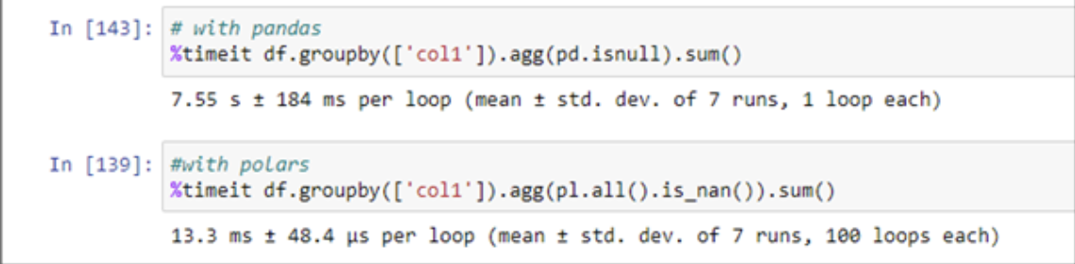
Performance comparison of Polars with Pandas
Using groupby and aggregation:
Polars groupby uses the lazy evaluation system that pushes the query into the query engine, optimizes it, and caches the intermediate results. Finally, the query is eagerly evaluated and then the result is produced.
This is fast compared to the very slow pandas groupby aggregation method. Under the hood, the query/statement translate from [df.query([‘col1’]).agg([pl.all().is_nan()).sum()] to
[df.lazy().groupby([‘col1’]).agg(pl.all().is_nan()).collect()]

Slide 43
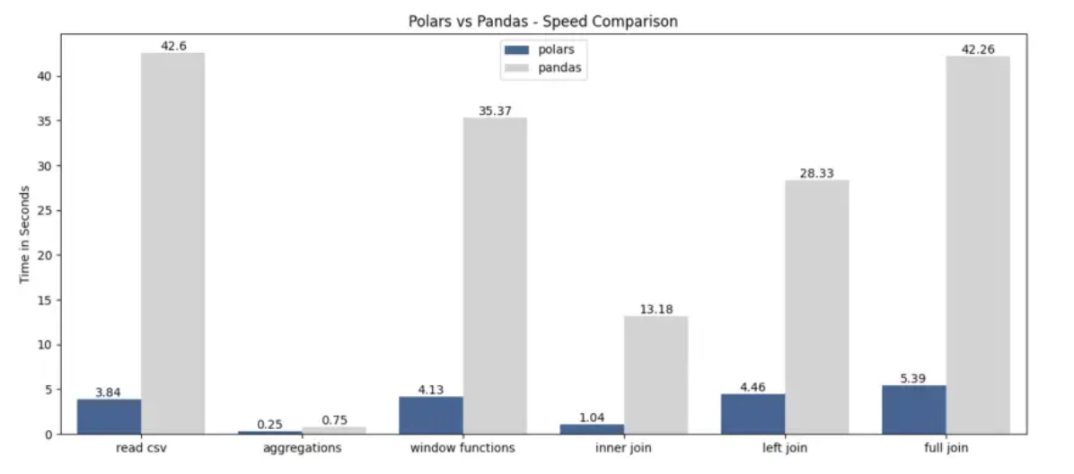
Performance comparison of Polars with Pandas

Slide 44
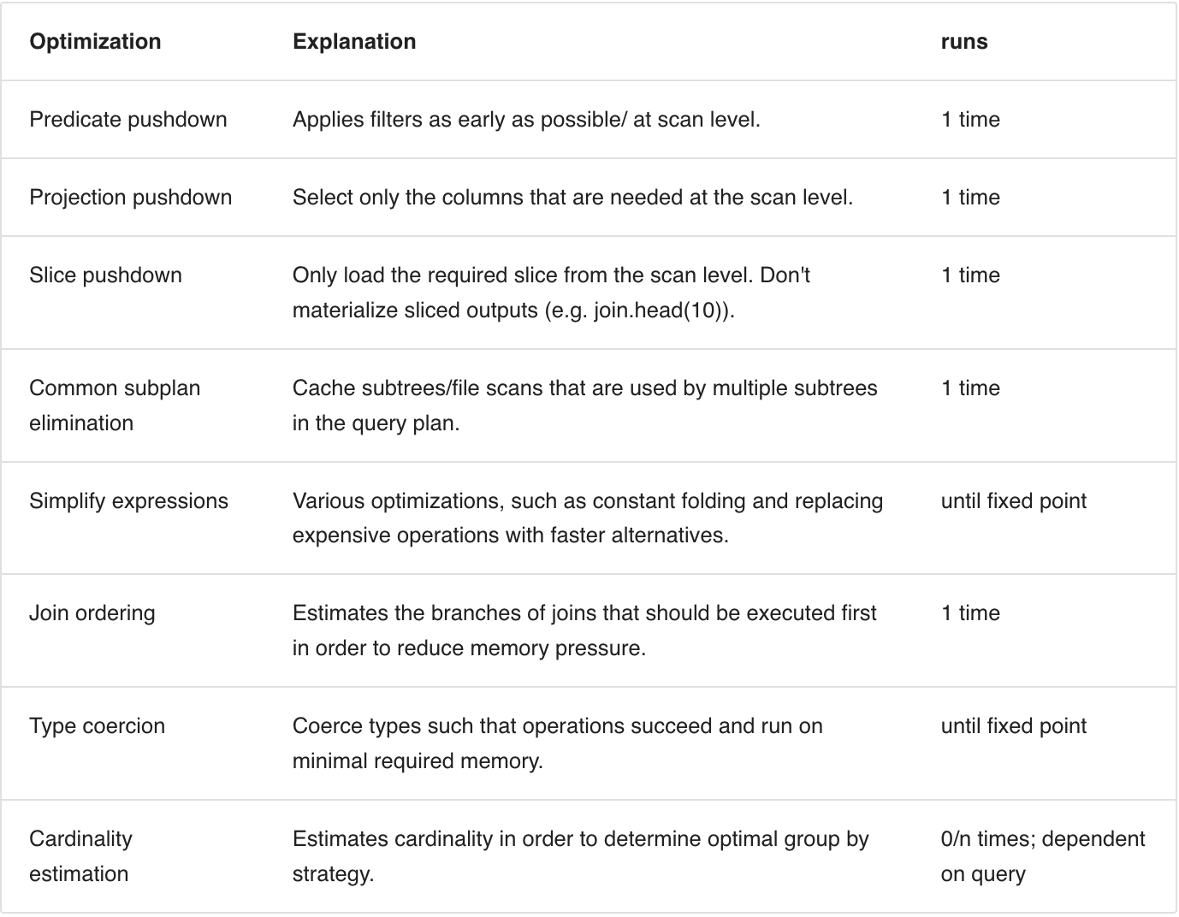
Polars Optimizations
If you use Polars' lazy API, Polars will run several optimizations. Some of them are executed up front, others are determined just in time as the materialized data comes in

Slide 45
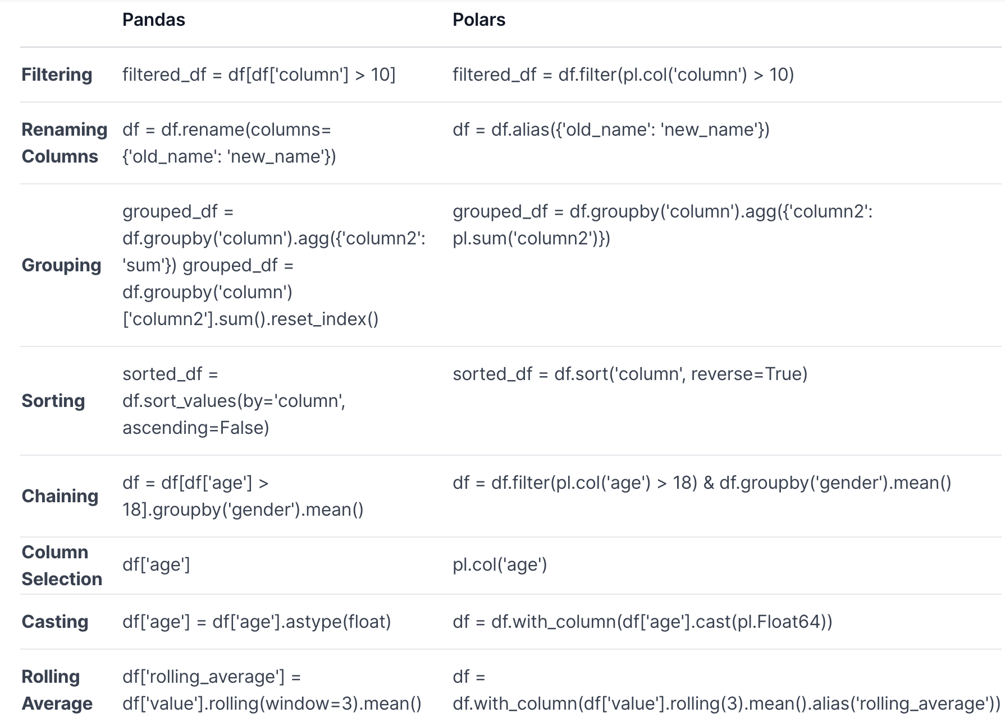
Polars syntax & API

Slide 46
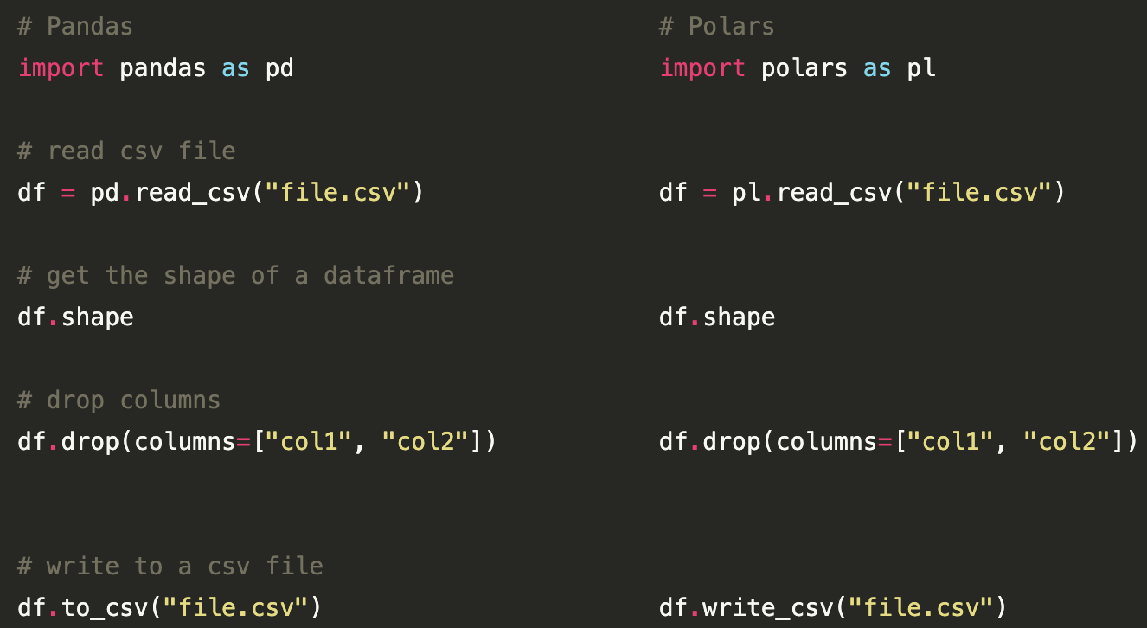
Polars syntax & API

Slide 47
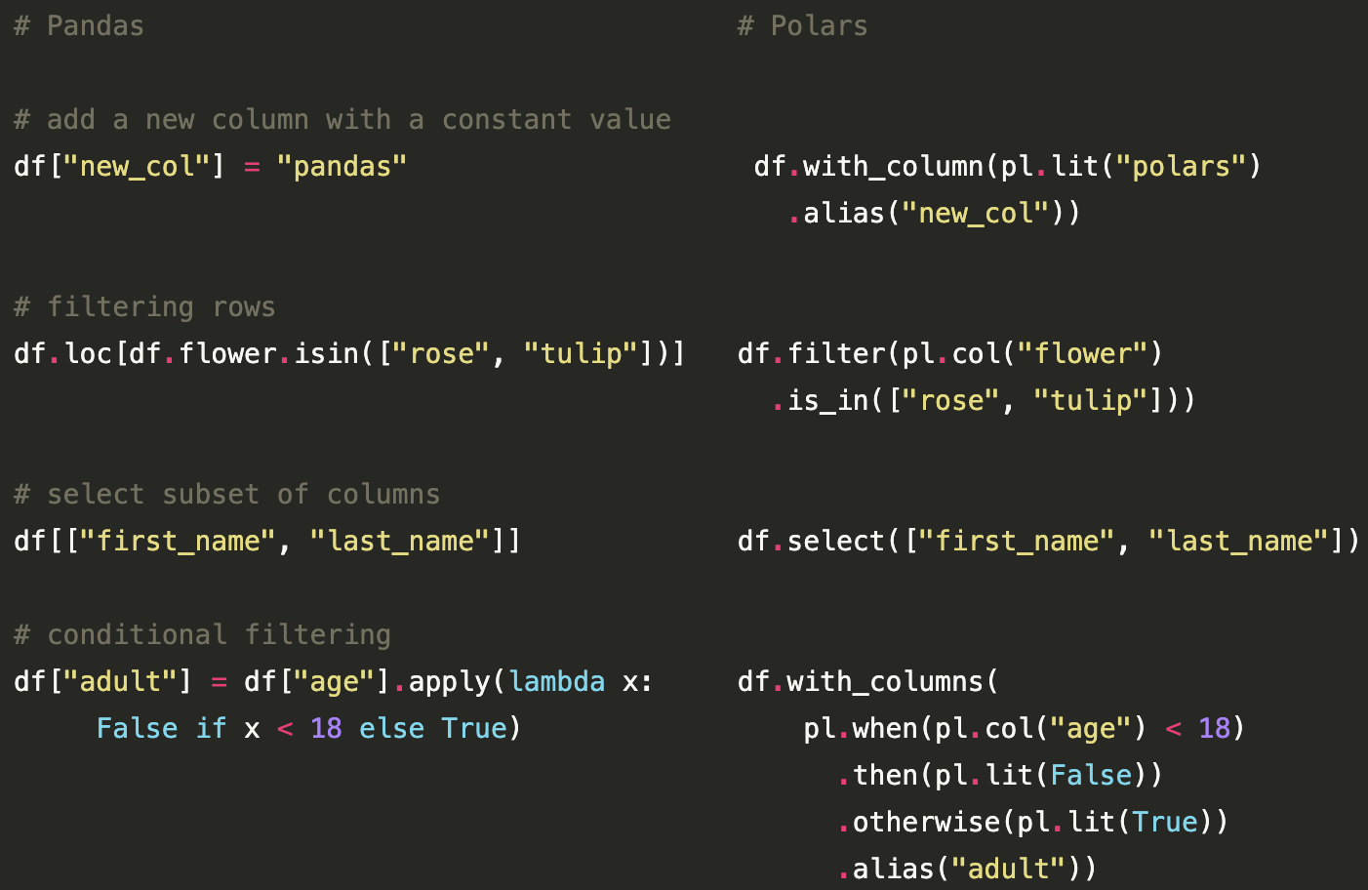
Polars syntax & API

Slide 48

Polars data support
Polars support reading and writing to all common data formats that we see in Pandas too
This allows easy integration of Polars into the existing data stack:
Text: csv & json
Binary: parquet, delta lake, avro & excel
IPC: feather, arrow
Databases: mysQL, postgres, sql server, sqlite, redshift &
oracle
Cloud Storage: s3, azure blob & azure File
Notes:
Apache Arrow defines an inter-process communication (IPC) mechanism to transfer a collection of Arrow columnar arrays (called a “record batch”). It can be used synchronously between processes using the Arrow “stream format”, or asynchronously by first persisting data on storage using the Arrow “file format”. Feather is a portable file format for storing Arrow tables or data frames (from languages like Python or R) that utilizes the Arrow IPC format internally

Slide 49
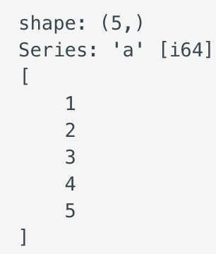
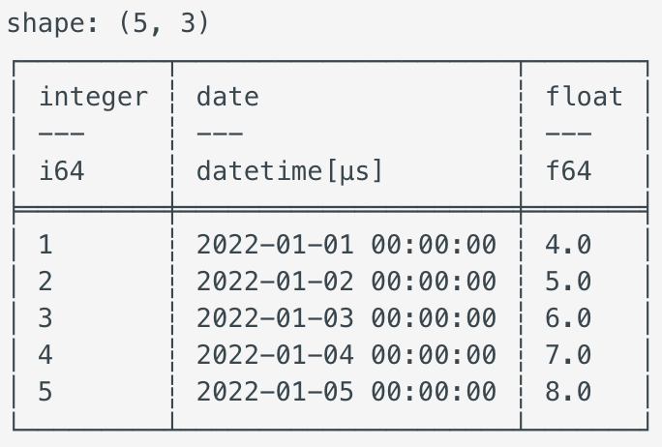

Polars Data Structures
The core base data structures of Polars are series & dataframe
Series is a 1-dimensional data structure with all elements having similar datatype:
Dataframe is a 2-dimensional data structure and a collection of series. Group By, Join, pivot are
some of the operations that can be performed

Slide 50

Polar Contexts
Polars developed its own Domain Specific Language(DSL) for data transformation
The two core components of DSL are Contexts & Expressions
Context refers to the context in which an expression is evaluated
There are 3 main contexts:
Selection df.select(...), df.with_columns(...)
Filtering df.filter()
Group by / Aggregation df.group_by(...).agg(...)

Slide 51
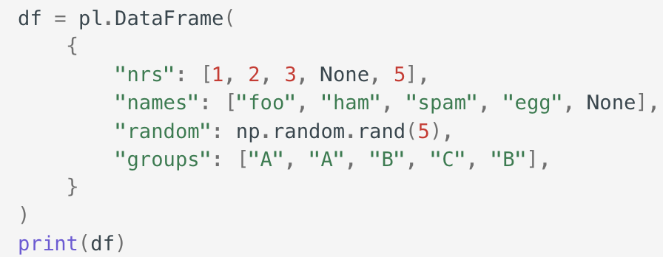
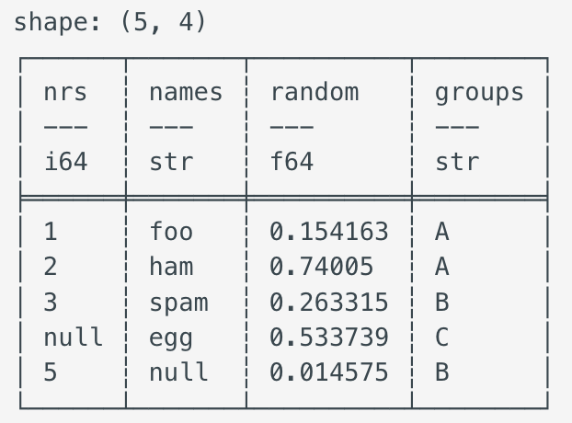
Polar Contexts
Selection:
The selection context applies expression on columns. A select may produce new columns that are aggregations, combinations of expressions, or literals

Slide 52
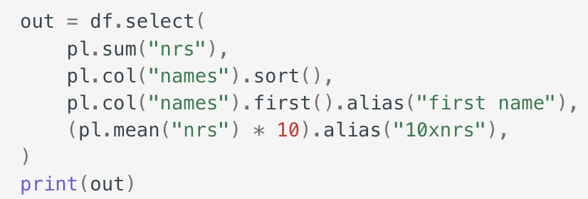
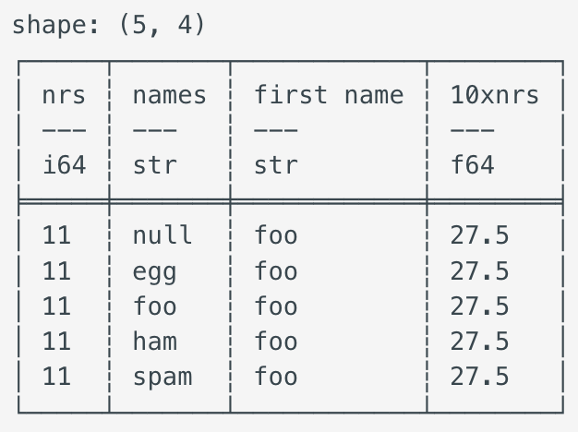
Polar Selection Context
The selection context is very powerful and allows to evaluate arbitrary expressions independent of (and in parallel to) each other.

Slide 53
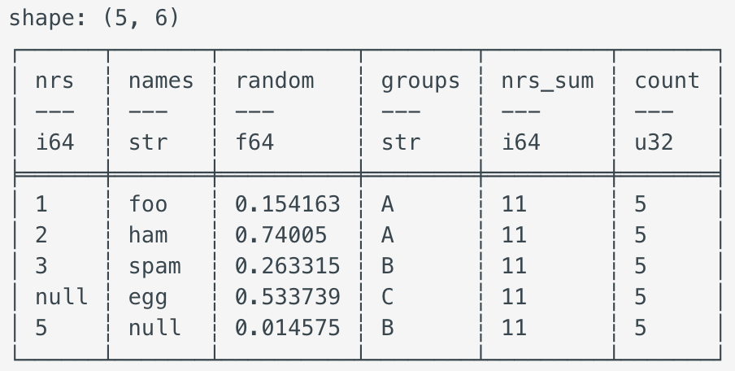
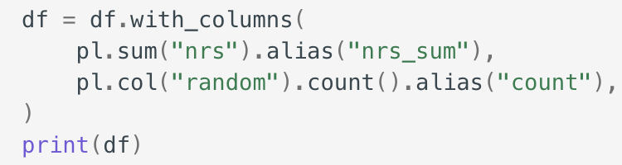
Polar Selection Context
Similar to the select statement, the with_columns statement also enters into the selection context. The main difference between with_columns and select is that with_columns retains the original columns and adds new ones, whereas select drops the original columns.

Slide 54
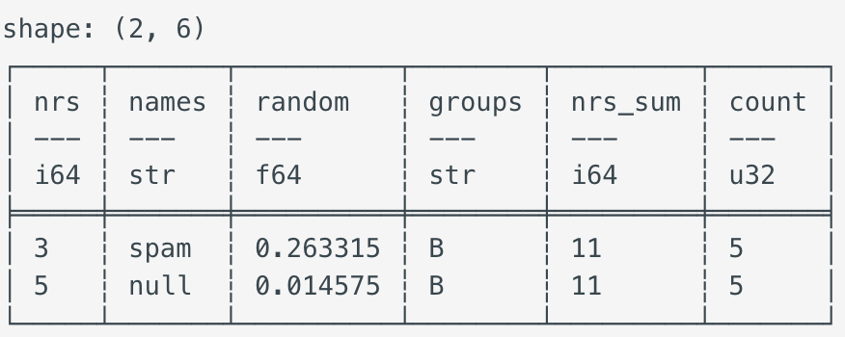

Polars Filtering Context
The filtering context filters a DataFrame based on one or more expressions that evaluate to the Boolean data type

Slide 55


Polars Group by / Aggregation Context
In the group_by context, expressions work on groups and thus may yield results of any length (a group may have many members)

Slide 56

Polars Expressions
Polars has a powerful concept called expressions that is central to its very fast performance.
Expressions are at the core of many data science operations:
taking a sample of rows from a column
multiplying values in a column
extracting a column of years from dates
convert a column of strings to lowercase
The power of expressions is that every expression produces a new expression, and that they can be piped together. You can run an expression by passing them to one of Polars execution contexts.
All expressions run in parallel separately and within an expression there may be more parallelization going on.

Slide 57


Polars Lazy/Eager API
Polars support two modes of operations: lazy & eager
In the eager API the query is executed immediately while in the lazy API the query is only evaluated once it is 'needed’
Deferring execution to last minute can have significant performance advantages that is why the Lazy API is preferred in most cases
In this example we use the eager API to:
Read the iris dataset.
Filter the dataset based on sepal length
Calculate the mean of the sepal width per species
Every step is executed immediately which can be wasteful as we may load extra unused data

Slide 58

Polars Lazy/Eager API
In lazy API we wait on execution until all steps are defined. The query planner performs these optimizations:
Predicate pushdown: Apply filters as early as possible while reading the dataset, thus only reading rows with sepal length greater than 5.
Projection Pushdown: Select only the columns that are needed while reading the dataset, thus removing the need to load additional columns (e.g. petal length & petal width)
These will significantly lower the load on memory & CPU thus allowing you to fit bigger datasets in memory and process faster. Once the query is defined you call collect to inform Polars that you want to execute it.

Slide 59
Poll Question
Which operation mode that polars utilizes defer execution until needed? (single selection)
Fast
Lazy
Eager
Slow

Slide 60

When to use Lazy vs Eager API
In general the lazy API should be preferred unless you are either interested in the intermediate results or are doing exploratory work and don't know yet what your query is going to look like
In many cases the eager API is calling the lazy API under the hood and immediately collecting the result. This has the benefit that within the query itself optimization(s) made by the query planner can still take place
Polars lazy API one of the most powerful features. Lazy API allows to specify a sequence of operations without immediately running them. Instead, these operations are saved as a computational graph and run when necessary.
This allows Polars to optimize queries before execution, catch schema errors before the data is processed, and perform memory-efficient queries on datasets that don’t fit into memory

Slide 61

Polars Streaming mode
Lazy API allows queries to be executed in a streaming mode
This means that Instead of processing data all-at-once, Polars can execute a query in batches allowing to process datasets that are larger-than-memory
Streaming mode is still in development stages & not all lazy
operations support it. Streaming is supported in:
filter, slice, head, tail, with_columns, select
group_by, join, unique, sort
explode, melt, scan_csv, scan_parquet, scan_ipc

Slide 62


Polars Streaming mode
Polars can handle larger-than-memory datasets with its streaming mode. In this mode Polars processes all data in batches rather than all at once.
It is worth keeping streaming switched on when working with larger datasets - particularly if you are building pipelines that you want to be ready to larger datasets in the future.
Simple example of streaming and non-streaming:
To work in streaming mode use streaming=True to collect when we evaluate a query.
Let’s create DataFrame with 1m rows, 100 floating point columns and integer ID column.
We then do a groupby on the id column and take the mean of the remaining columns.
We execute the query in streaming mode with the streaming=True argument
If we compare this query with streaming=True and streaming=False (the default): 75 ms for streaming and 120 ms for non-streaming. For Pandas this takes about 330 ms for comparison.
Notes:
If we compare this query with streaming=True and streaming=False (the default) I get an average of 75 ms for streaming and 120 ms for non-streaming. For Pandas this takes about 330 ms for comparison.

Slide 63


Pandas 2.0 vs Polars
Pandas 2.0 includes range of new features towards making pandas faster & memory efficient to handle complex tasks
Pandas 2.0 includes the more robust memory management PyArrow
Users can choose btw the traditional NumPy backend or the brand-new PyArrow backend
PyArrow is a Python interface for handling large datasets using arrow memory structures
Another features include copy-on-write to improve performance by saving memory resources.
This keeps a lazy copy of Pandas objects, such as series & dataframe rather than cached copied of objects. These methods return views when Copy-on-Write is enabled, which provides significant performance improvement compared to the regular execution
Notes:
Apache Arrow is a language-agnostic software framework for developing data analytics applications that process columnar data. It contains a standardized column-oriented memory format that is able to represent flat and hierarchical data for efficient analytic operations on modern CPU and GPU hardware

Slide 64
Pandas 2.0 vs Polars performance comparison
Test | Pandas 2.0 | Polars | Winner | Syntax Similarity
Import Test | Reading all rows and then filtering unwanted rows using .query() method | Directly reads only the rows of interest using filter() method | Polars (better performance) | Similar, but with differences due to underlying implementation (.query() vs filter())
Group By Test | Uses .groupby() for aggregating operations such as mean and median of sales by office and month | Same as pandas, but with better performance | Polars (better performance) | Similar
Rolling Statistics Test | Uses rolling() method combined with other methods, such as mean(), for rolling mean calculations | Uses rolling_mean() method for rolling mean calculations | Polars (better performance) | Similar, but with slight differences (.rolling().mean() vs rolling_mean())
Sampling Test | Uses numpy for bootstrap sampling operations | Uses built-in sample() method for bootstrap sampling operations | Polars (nearly x5 times faster) | Different, pandas relies on numpy while polars has built-in methods
Compound Manipulations Test | Performs join operation with another dataset and then sorts and selects data | Performs same tasks but more efficiently | Polars (significantly faster) | Similar, but with slight differences (merge().query().sort_values().head() vs join().filter().sort().head().select())

Slide 65


What’s new in Pandas 2.2
Pandas 2.2.0 released on Jan 19,2024
Improved PyArrow Support:
Lists & structs were NumPy object dtype before
Now Arrow type backend provides much easier way for lists & structs
This is a series that contains a dictionary in every row.
Previously, this was only possible with numpy object dtype and
accessing elements from these rows required iterating over them.

Slide 66

What’s new in Pandas 2.2
The struct accessor now enables direct access to certain attributes:

Slide 67

What’s new in Pandas 2.2
Integrating the Apache ADBC Driver:
Pandas used sqlalchemy to read data from sql database but was very slow
Alchemy reads data row-wise while pandas has columnar layout which makes reading & moving data into a dataframe slower than necessary
The ADBC driver from the Apache Arrow project enables users to read data in a columnar layout, which brings huge performance improvements
The ADBC Driver currently supports postgres and sqlite.
case_when:
Pandas 2.2 adds a new case_when method, that is
defined on a Series. It operates similarly to what sql does

Slide 68

Polars for ETL
Extract, transform, and load (ETL) is a process of combining data from multiple sources into a large, central repository called a data warehouse. ETL uses a set of business rules to clean and organize raw data and prepare it for storage, data analytics, and machine learning (ML).
Organizations today have both structured and unstructured data from various sources including:
Customer data from online payment and customer relationship management (CRM) systems
Inventory and operations data from vendor systems
Sensor data from Internet of Things (IoT) devices
Marketing data from social media and customer feedback
Employee data from internal human resources systems
Polars speed, simplicity, fast data ingestion & no memory constraints make it an ideal choice for ETL

Slide 69
When should we stick with Pandas
Pandas is good for small to medium scale projects and is still the best package in many scenarios like data exploration & machine learning because:
Interoperability: Polars has extensive interoperability with packages using Arrow but not compatible with python data visualization & machine learning libraries like scikit-learn & pytorch. Plotly does support polars
Tooling: Polars proves to be faster for data manipulation. However, pandas is still the best for data exploration and machine learning tasks. As the Python ecosystem evolves, the compatibility gap between Polars and other libraries may narrow, making Polars an even more compelling option in the future

Slide 70
How can we improve data mining performance
Reducing copying with copying-on-write:
In traditional data manipulation tools, every data operation leads to creation of a new copy of the entire dataframe. This behavior can be problematic for memory resources when dealing with large datasets.
Copy-on-write is most common technique to solve this issue. It is a resource-management technique that allows to efficiently implement a "duplicate" or "copy" operation on modifiable resources. That means that if a dataset is duplicated but not (entirely) modified, it is not necessary to create a new resource. Instead, the memory resources can be shared between copy and original.

Slide 71

How can we improve data mining performance
Parallel Computation:
Pandas is threaded and does not have parallel computing techniques. Parallel computing is done by either multi-core machines or distributed computing (i.e., a group of computers working together in a cluster).
Example: To calculate mean age of basketball players grouped by teams, we could use parallel computing to assign calculation of mean of each group
to one core or machine instead of
calculating them one by one, thereby
increasing performance

Slide 72
How can we improve data mining performance
Optimizing data import:
Reading large datasets is often time consuming in pandas and polars provides faster alternative.
Here are some techniques that can help improve performance when reading data files:
Data Chunking:
Instead of reading full file, we can break it into little pieces, aka chunks. This technique allows for faster data importing while reducing memory required to store it all simultaneously.
Read only required columns:
Instead of reading whole dataset, use a preliminary filter and read only the required columns as polars does
Downcasting data types.
Tools like pandas have a default behavior when assigning data types to imported columns. Sometimes, there may be other available types that require less memory without losing information. Downcasting is a process of changing data types into the smallest type that can handle its value

Slide 73

How can we improve data mining performance
Lazy Evaluation and Query Planning
The order of operations affects performance. We can reorder some computations and get same answer more efficiently.
There are two strategies to achieve this: lazy evaluation and query planning. The former refers to process of delaying computations until absolutely necessary. In contrast, the latter is a process of finding most efficient way of performing multiple data manipulations given a set of different queries. To do so, query planning normally involves use of a query optimizer.
Out-of-Core Processing
Pandas store entire datasets in memory which is not efficient when working with large datasets. Out-of-core processing refers to external memory (e.g., an external disk) that stores data that couldn’t fit in core memory. It processes externally stored data in chunks and gives the same results.

Slide 74
What are Some High-Performance pandas Alternatives?
Besides Polars some high performance pandas alternatives are:
Koalas. A pandas API built on top of PySpark. If you use Spark, you should consider this tool.
Vaex. A pandas API for out-of-memory computation for analyzing big data at billion rows per second.
Modin. A pandas API for parallel programming, based on Dask or Ray frameworks for big data projects. If you use Dask or Ray, Modin is a great resource.
cuDF. Part of the RAPIDS project, cuDF is a pandas-like API for GPU computation that relies on NVIDIA GPUs or other parts of RAPIDS to perform high-speed data manipulation.

Slide 75
Poll Question
How does polars process larger than memory datasets? (multiple selection)
Non-streaming mode
Streaming mode
Dynamic threshold
Batches of data
Multi-processing
Multi-threading

Slide 76
Why choose Polars
Though Pandas is most widely used it has limitations when dealing with large datasets. The core mission of Polars is to offer a lightning-fast dataframe library that addresses the problems of pandas.
Written in Rusk (a powerful programming language that provides C/C++ performance and allows to fully control performance critical parts in a query engine), polars integrates state-of-the-art methodologies to increase performance, designed to:
Enhance parallel computing using all available cores & optimize queries to reduce unneeded work/memory allocations using lazy evaluation and query planning.
Improve storage performance by using copy-on-write semantics and Apache Arrow.
Handle datasets much larger using its out-of-core data capabilities through its streaming API.
An important feature of polars is that it has a pretty similar syntax to pandas and shares the same building blocks, such as series and dataframes.

Slide 77


Polars code execution
In the code above on the Reddit CSV, Polars takes each line of code, adds it to the internal query graph and optimizes the query graph. When we execute the code Polars executes the optimized query graph by default.
Execution on the full dataset:

Slide 78


Polars code execution
Above we see that from the 10 million rows there are 14,029 rows that match our predicate.
With the default collect method Polars processes all data as one batch. This means that all the data has to fit into available memory at the point of peak memory usage in query.

Slide 79

Polars code execution
Execution on larger-than-memory data:
If data requires more memory than available Polars processes the data in batches using streaming mode. To use streaming mode simply pass the streaming=True argument to collect
Execution on a partial dataset:
While writing, optimizing or checking query on a large dataset, querying all available data may lead to a slow development process. We can execute query with .fetch method. The .fetch method takes a parameter n_rows and tries to 'fetch' that number of rows at the data source. Here we "fetch" 100 rows from the source file and apply the predicates.

Slide 80

Polars code execution

Slide 81

Polars Query Optimizations
If you use Polars' lazy API, Polars will run several optimizations on your query. Some of them are executed up front, others are determined just in time as the materialized data comes in. Here is a non-complete overview of optimizations done by polars, what they do and how often they run:

Slide 82

How Polars will make your life easier

Slide 83


Multithreading & Parallel Computing
Multithreading refers to the concurrent execution of more than one sequential set (thread) of instructions.
Multithreaded programming is programming multiple, concurrent execution threads. These threads could run on a single processor. Or there could be multiple threads running on multiple processor cores.
Parallel programming is a process of using a set of resources to solve a problem in less time by dividing the work.
Multiprocessing implements parallelism. Multiprocessing allocates separate memory and resources for each program — or process. But multithreading shares the same memory and resources for threads belonging to the same process.
Polars uses all your CPU cores. It does this by executing computations which can be done in parallel in separate threads.
For example, requesting two expressions in a select statement can be done in parallel, with the results combined at the end. Another example is aggregating a value within groups using group_by().agg(<expr>), each group can be evaluated separately.

Slide 84

Polars in Big Data Analysis, Machine Learning & Data Science
Polars & Big Data Analysis: In big data analysis, processing large datasets efficiently is crucial. Polars, with its fast execution speed and memory efficiency, is an excellent tool for such tasks. Its ability to handle large datasets and perform complex operations efficiently makes it a preferred choice for big data analysis.
Polars in Machine Learning: Machine learning involves working with large datasets and requires efficient data manipulation for feature extraction, data cleaning, and preprocessing. Polars’ efficient dataframe manipulation capabilities can significantly speed up these processes, making it a useful tool for machine learning practitioners.
Polars for Data Science: Data science involves extracting insights from data, which often requires efficient data manipulation. Polars, with its wide range of features for dataframe manipulation, can help data scientists clean, transform, and analyze their data more efficiently.

Slide 85

Conclusion
Use pandas and polars together to make data processing tasks more efficient, swap out the parts that are slow with polars and leave the rest of the code in pandas. It’s easy to switch between pandas and polars
You can convert a pandas dataframe to polars: df_pl = pl.from_pandas(df_pd) and vice versa: df_pd = pl.to_pandas(). This facilitates refactoring existing code and to use third party libraries that only support Pandas.
Polars is a powerful library for handling large datasets, complex data types and offers easy integration with other python libraries such as numpy and pyarrow
Polars’ optimized back end, familiar yet efficient syntax, lazy API, and integration with the python ecosystem make the library stand out among the crowd.
Polars mission is to provide seamless data processing experience on any scale
When working with big datasets, performance improvement is crucial, Polars takes charge

Slide 86
References
https://pandas.pydata.org/docs/dev/getting_started/overview.html
https://realpython.com/polars-python/
https://docs.pola.rs/user-guide/
https://www.einblick.ai/tools/what-is-polars-python-compare-pandas/
https://blog.jetbrains.com/dataspell/2023/08/polars-vs-pandas-what-s-the-difference/
https://towardsdatascience.com/whats-new-in-pandas-2-2-e3afe6f341f5
https://www.linkedin.com/pulse/polars-vs-pandas-which-one-faster-benchmarking-analysis-saleem/
https://www.rust-lang.org/
https://rotational.io/blog/introduction-to-polars/
https://www.rhosignal.com/posts/polars-dont-fear-streaming/
https://www.perforce.com/blog/qac/multithreading-parallel-programming-c-cpp
https://ioflood.com/blog/polars/

